Slide 1
Mind the Gap
Exploring Gaps in Medicaid Coverage in the United States
Michael Shaffer, DA-14, Nashville Software School

Slide 2

Presentation Overview
Objective
Background
Enrollment Criteria
State-Level Enrollment Gaps
Age/Income
County-Level Enrollment Gaps
Age/Income
Digging Deeper

Slide 3

Objective
Identify counties where gaps in coverage vs. eligibility are largest
Criteria by category
Age
Income
Dive deeper into regions identified as having large enrollment gaps
Investigate possible explanations

Slide 4

Background
While Medicaid enrollment fluctuate across years, the overall trend shows increase in program utilization since February 2020*
New budgetary proposals have potential to reduce access
Reduced funding
New enrollment criteria
*kff.org, Medicaid Enrollment and Unwinding Tracker

Slide 5

Enrollment Criteria
Age
Income
All children are eligible if no other insurance is available
Up to age 19
Seniors age 65+
Assets below $2,000
Threshold varies by state
Range:
$967 per month ($11,640/year) to
$1,801 per month ($21,612/year)
Special Cases: Kentucky & Maryland
Supplemental Security Income (SSI)
SSI Eligibility: $2,019/month ($24,228/year)

Slide 6

Enrollment Criteria
Disability
Physical
Paralysis, brain injury
Neurological
Epilepsy, Alzheimer’s
Mental Health
Schizophrenia, bipolar disorder
Intellectual
Cerebral palsy, Down syndrome

Slide 7
State-Level Coverage Gaps

Slide 8
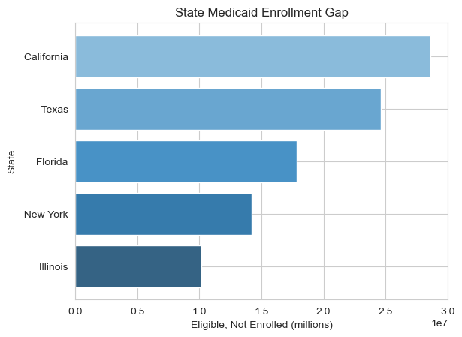
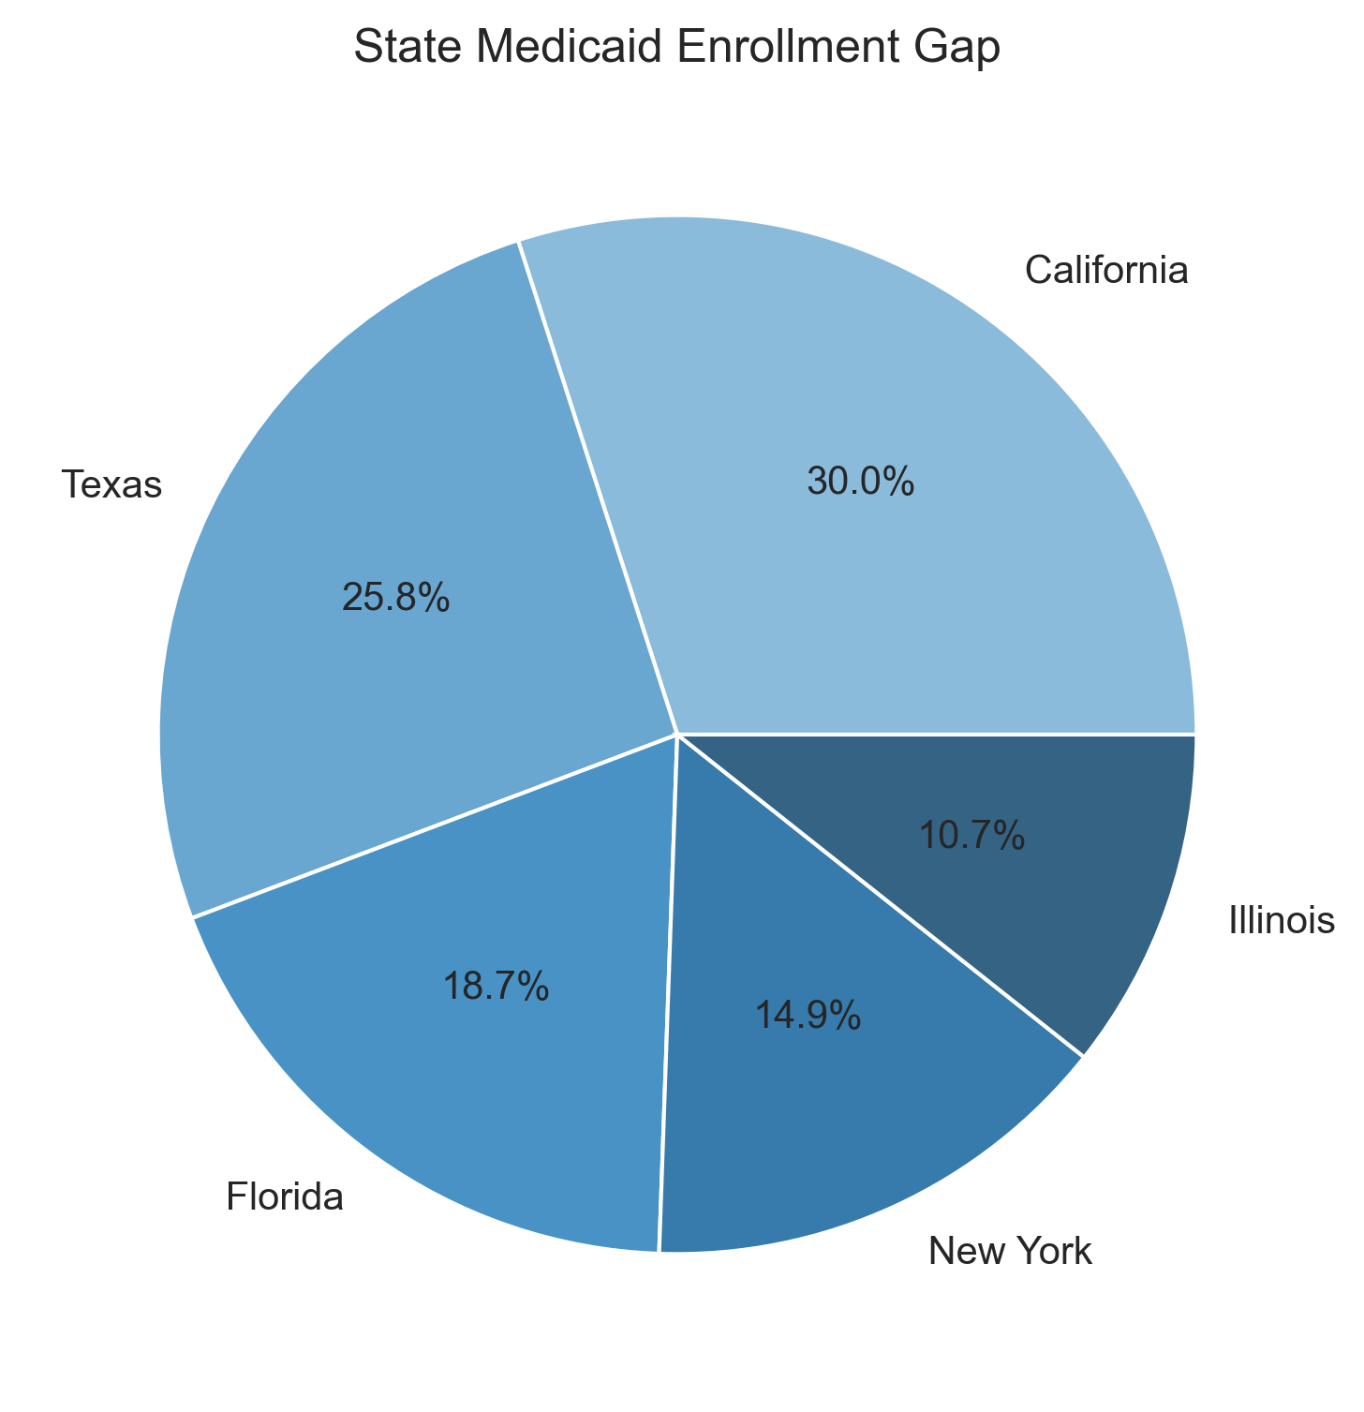
Overall State Enrollment Gap

Slide 9
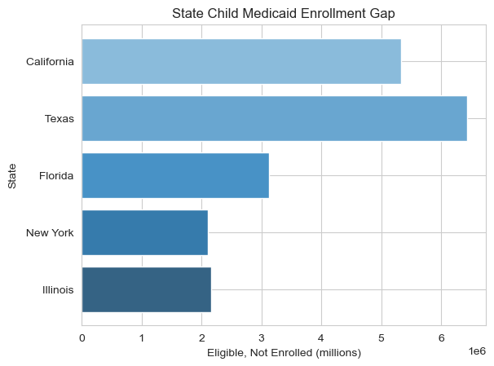
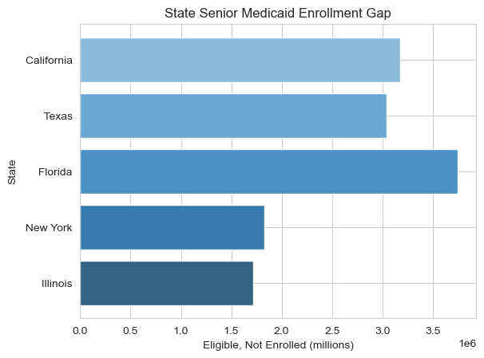
State Child & Senior Coverage Gap

Slide 10
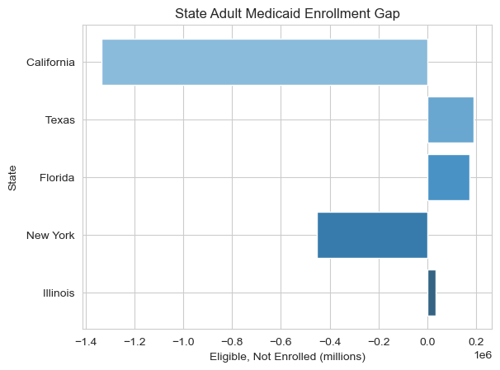
State Adult Coverage Gap

Slide 11
County-Level Coverage Gaps

Slide 12
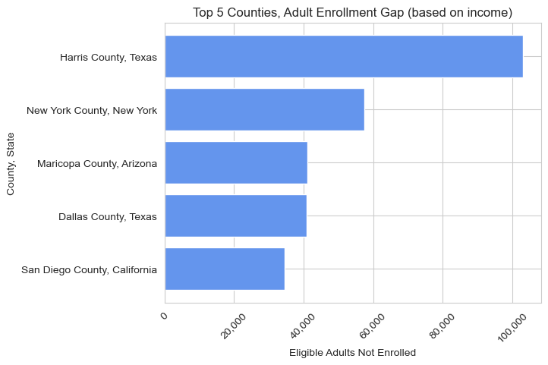
County Adult Coverage Gap

Slide 13
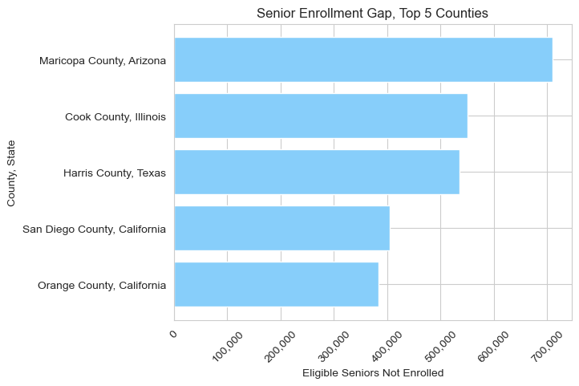
County Senior Coverage Gap

Slide 14
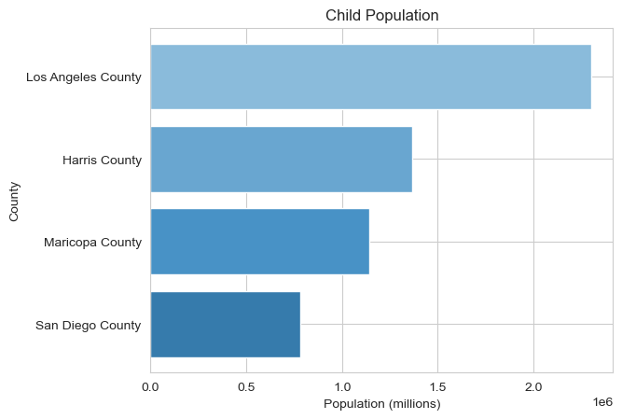
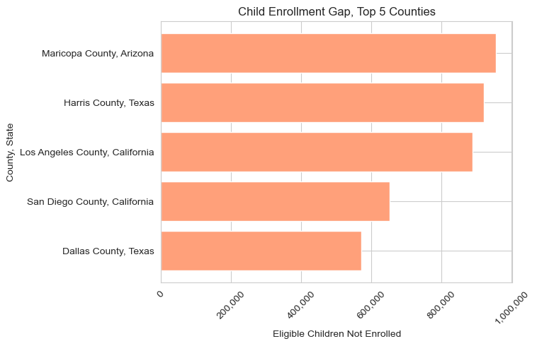
County Child Coverage Gap

Slide 15
Digging Deeper
Falling into the gap

Slide 16

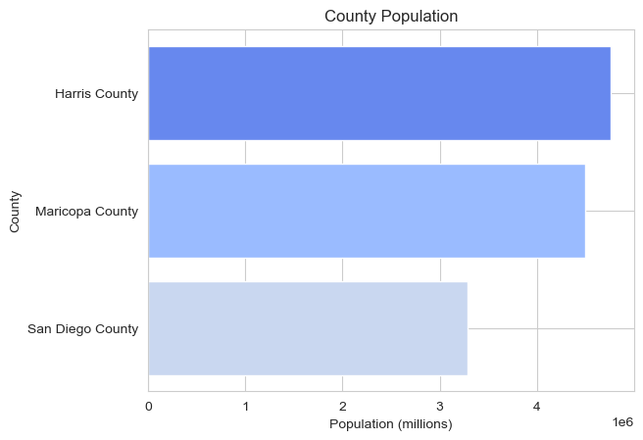


“Frequent Fliers”
Counties that appear most frequently all house large cities.
Harris County, TX
City: Houston
Maricopa County, AZ
City: Phoenix
San Diego County, CA
City: San Diego

Slide 17
“Frequent Fliers”
Counties that appear most frequently all house large cities.
Citizenship Status
Non-Citizens not eligible for Medicaid
Non-Citizens are counted in the Census
Higher concentrations of non-citizens equal higher coverage gaps
Harris County, TX
City: Houston
Maricopa County, AZ
City: Phoenix
San Diego County, CA
City: San Diego

Slide 18
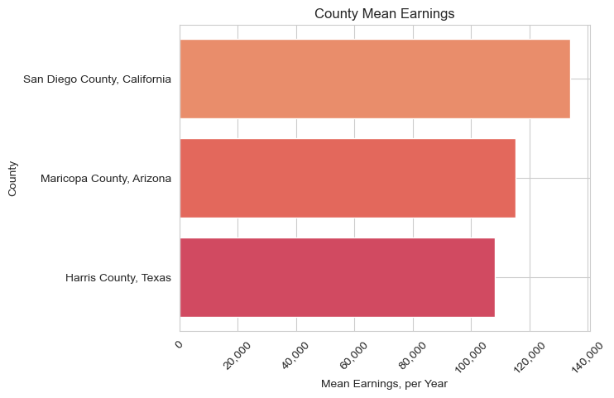
“Frequent Fliers”
Counties that appear most frequently all house large cities.
Citizenship Status
Non-Citizens not eligible for Medicaid
Non-Citizens are counted in the Census
Higher concentrations of non-citizens equal higher coverage gaps
Higher mean income
More residents with private insurance
Harris County, TX
City: Houston
Maricopa County, AZ
City: Phoenix
San Diego County, CA
City: San Diego

Slide 19
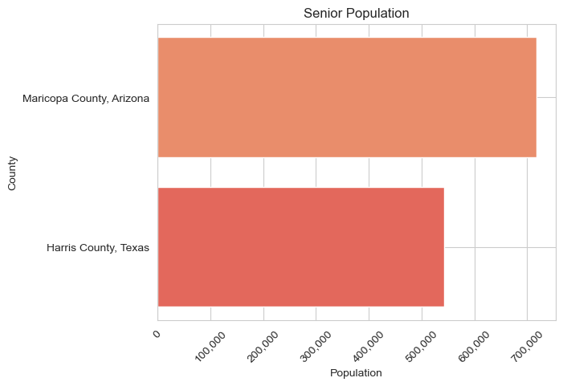
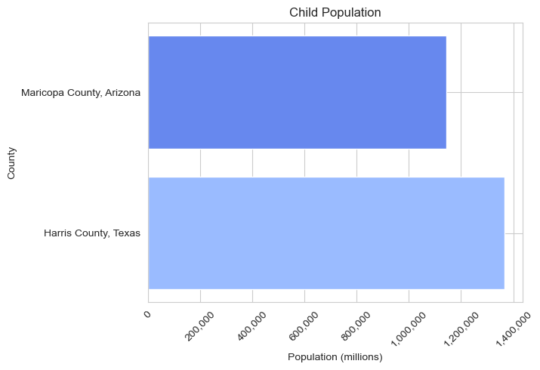
Demographic Variance
Population as a Confound
Senor Population Concentration
Harris County, Maricopa County
In Top 5 Highest Senior Population
Children and Medicaid Enrollment
Generally Healthier
Less likely to need long-term care
Less likely to enroll in Medicaid

Slide 20
Regions of High Enrollment

Slide 21
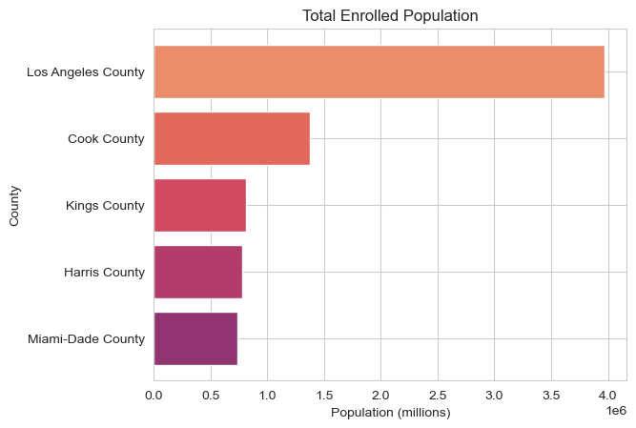
Areas of Highest Utilization

Slide 22
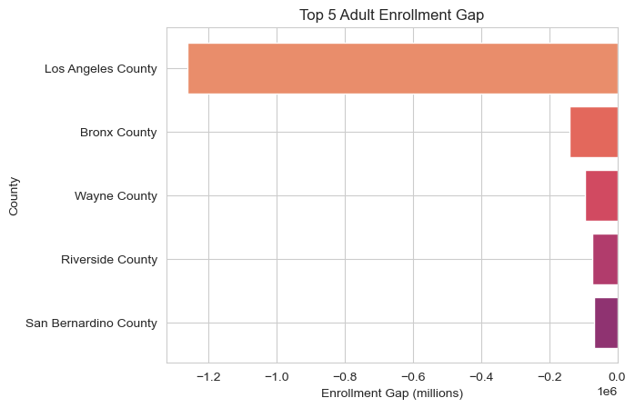
Areas of Highest Utilization

Slide 23
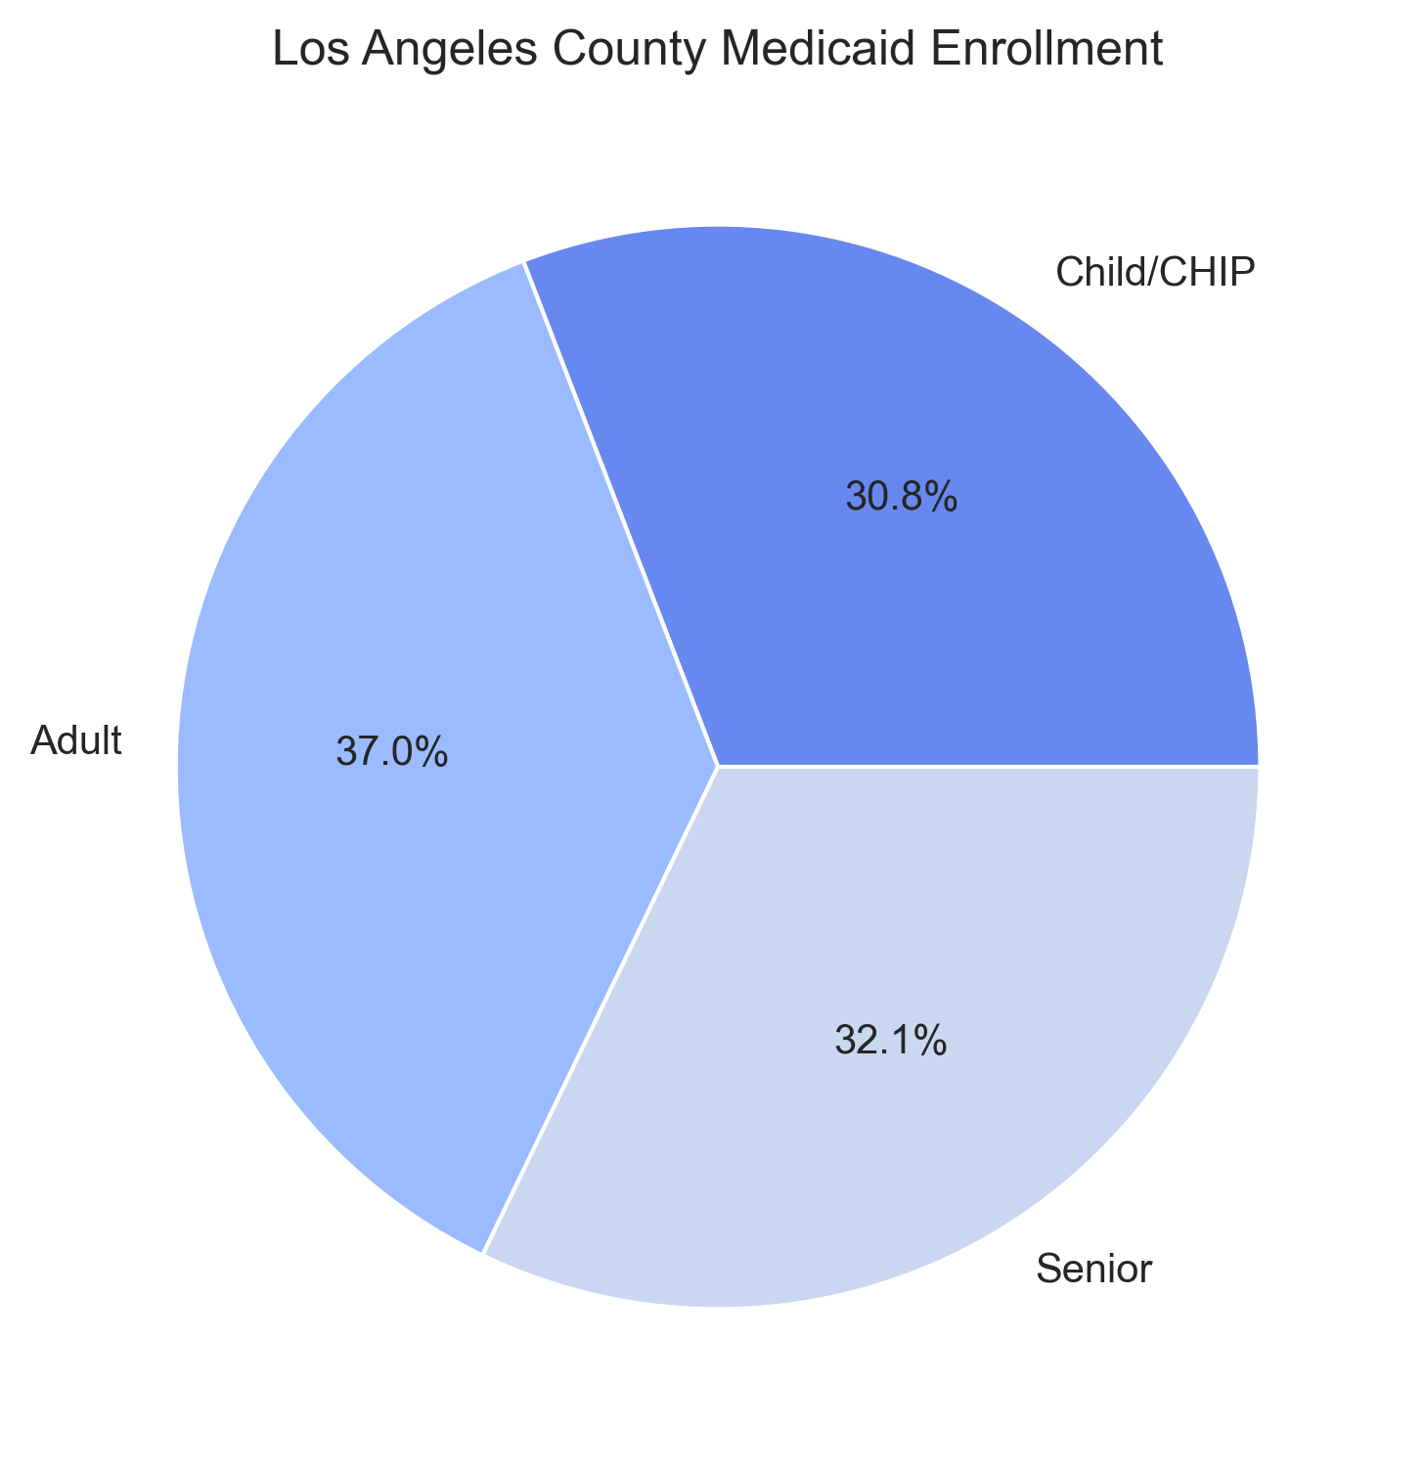
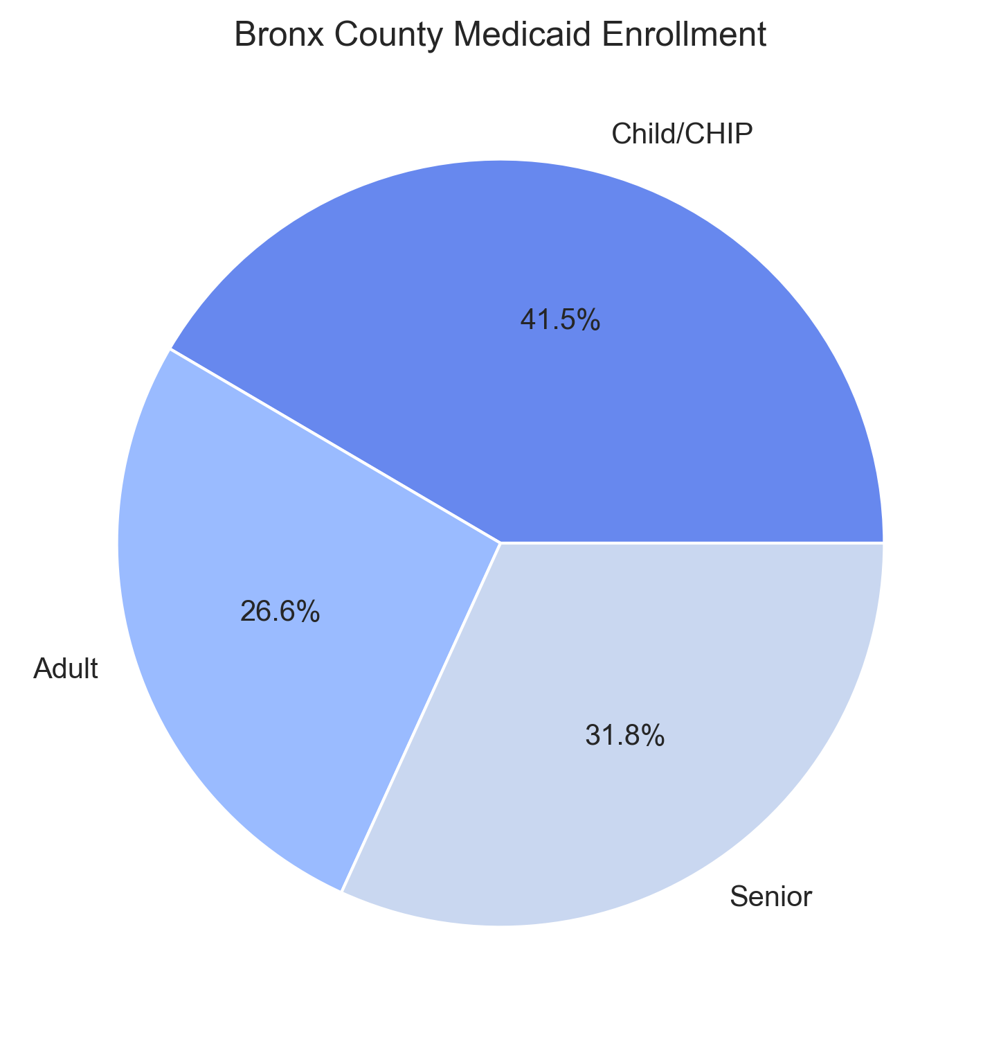
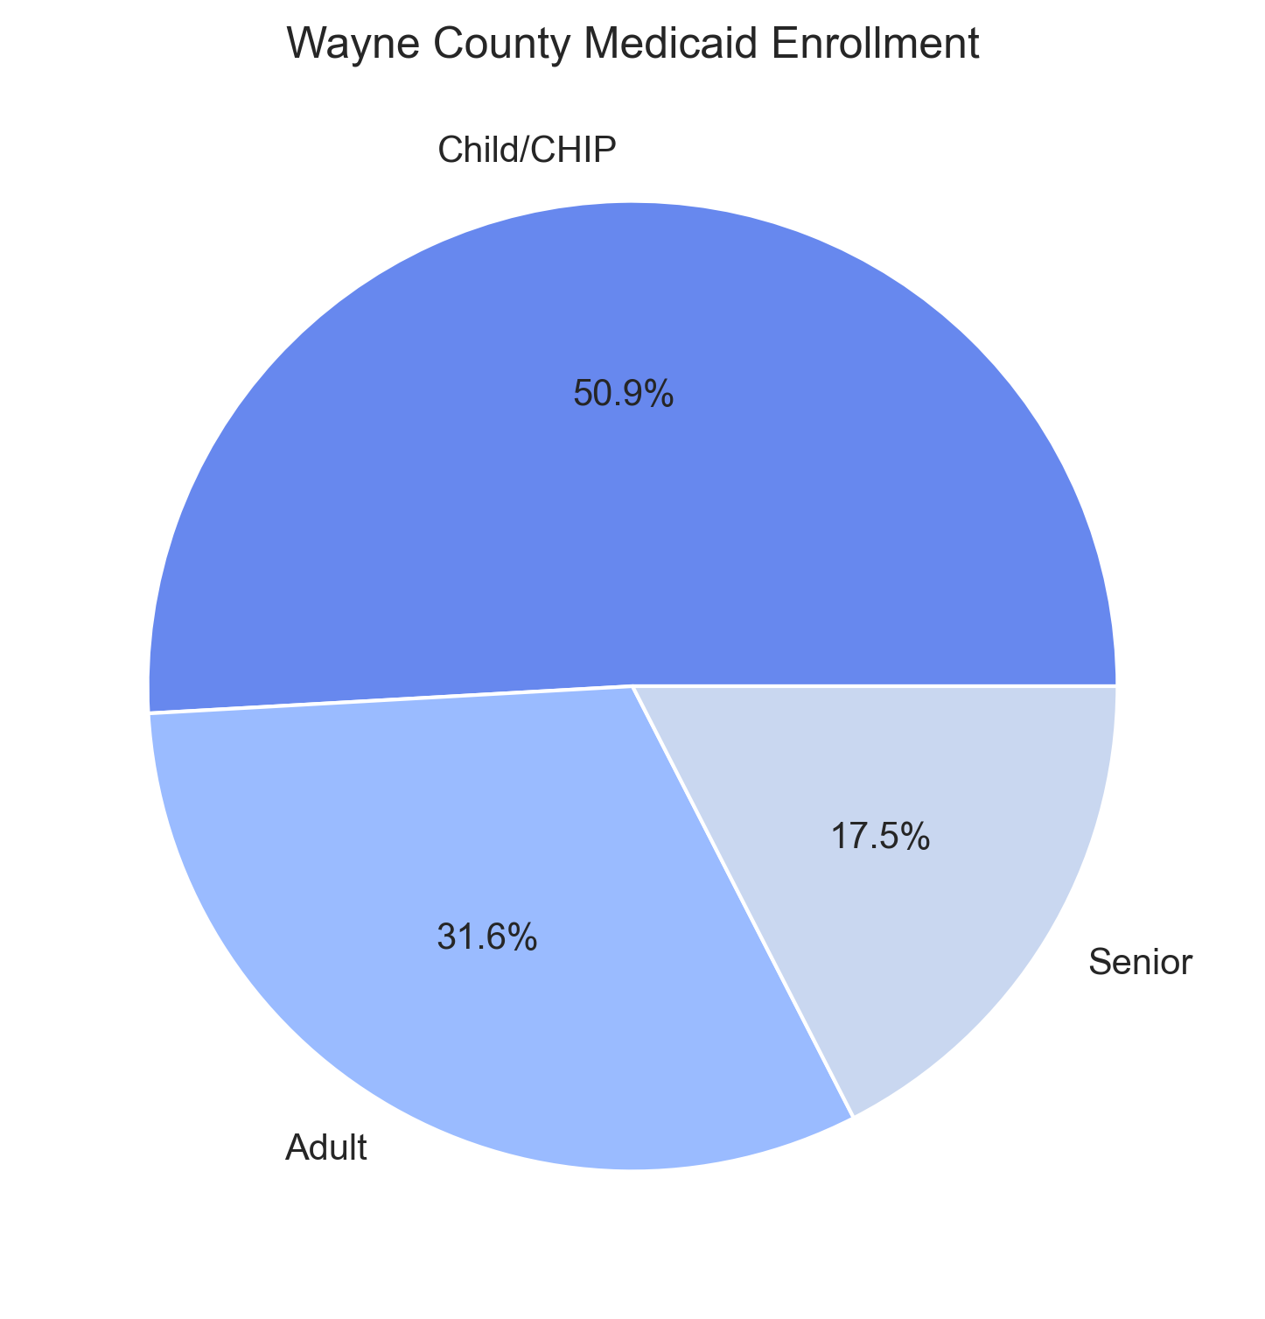
Areas of Highest Utilization

Slide 24
Wait… Where’s Rural America?!

Slide 25
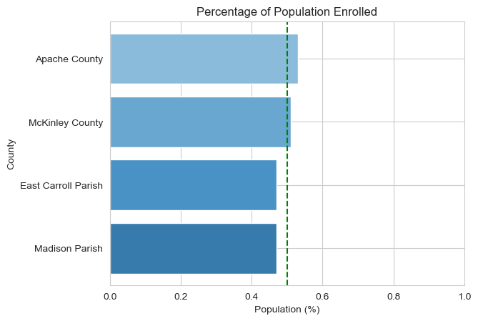
Highest Percentage of Total Population Enrolled

Slide 26
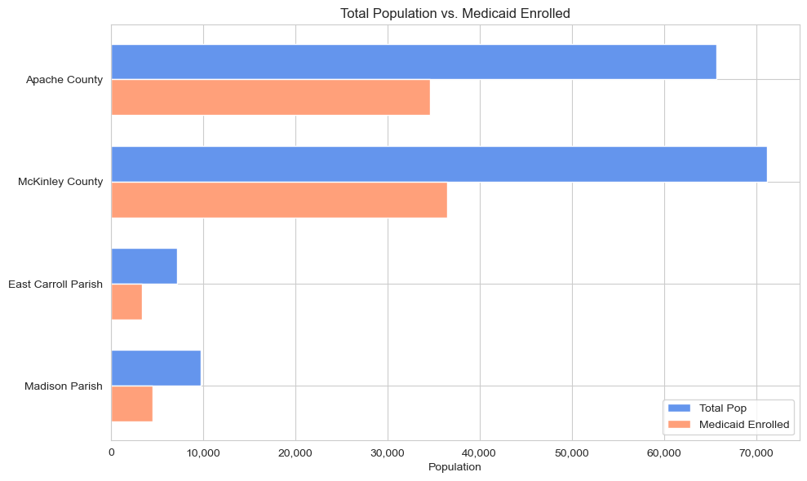
Highest Percentage of Total Population Enrolled*
*Bronx County excluded from this graph due exponentially larger population skewing graph values

Slide 27

Discussion
“… I’ll give you a topic.”
-Linda Richman

Slide 28
… discuss
Population is a big factor in predicting enrollment gap
Higher population equals higher utilization
... but also higher potential for gaps based on volume.
Higher Enrollment % vs. Total Population usually indicative of a rural area (<50K)
76% of counties in Top 25 for enrollment percentages had fewer than 50K residents
100% in Top 25 had negative gap scores, indicating utilization beyond income criteria
Potentially disabled enrollees

Slide 29

Thank you!!
Mind The Gap, Michael Shaffer, DA-14, Nashville Software School

